Slide 1


Epidemiology of Pertussis in Spain
Josefa Masa Calles
Surveillance of Vaccine Preventable Diseases
National Center of Epidemiology
Institute of Health Carlos III.CIBERESP. ISCIII
Pertussis: an emerging disease? Monday, 17 October 2016

Slide 2
“Pertussis is a frequent, highly contagious and serious infectious disease. In Spain was
considered as a disease with mandatory notification as early as 1901”
The Spanish Surveillance System (RENAVE)
60 Infectious
Diseases
Surveillance of Healthcare-associated infections (HAIs)
Outbreak
Surveillance
Surveillance of Antimicrobial Resistence
Pertussis

Slide 3
The main features of Spanish Surveillance System
The System:
Decentralized
Coordinated by Ministry of Health & Institute of Public Health (ISCIII)
The Surveillance:
  Mandatory
  Passive
  Comprehensive: cover the entire population
  Case-based with Case definition and Outbreak definition
  Laboratory information integrated

Slide 4

Pertussis Surveillance in Spain. Reporting flow chart
MofH
International
WHO Regional Office for Europe (CISID)
ECDC (Tessy)
Analysis &Evaluation
Technical assistance
to Vaccination Program
Reporting to ECDC &WHO
National Centre of Epidemiology
(through SIVIEs)
National
Autonomous
community
19 Autonomous Epidemiology Surveillance
Hospital and other Laboratories
Investigation
Control measures
Local/Área
Physicians Primary care + Hospitals
Public + Private
Reporting
Investigation

Slide 5
Adapt to EU case definition
Update the evidences in diagnosis and control
Improve Timeliness of Reporting
Expand the core variables to be reported Complications, Hospitalization and Death

Slide 6
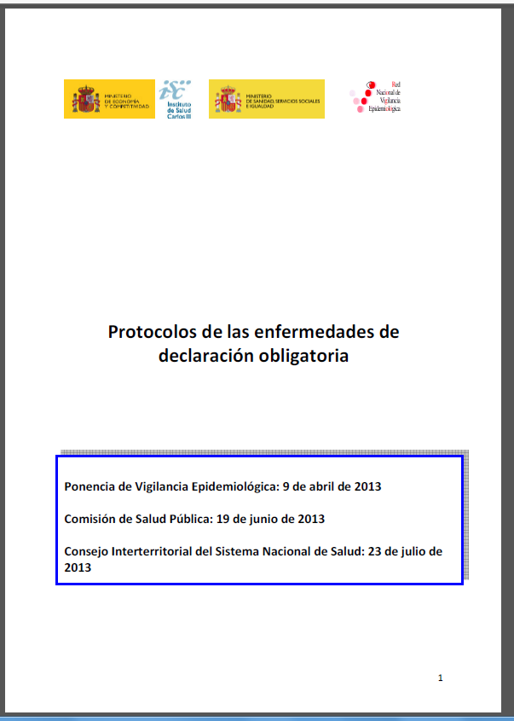
Surveillance Guidelines (Protocolos)
National Surveillance Guidelines
Cases & Outbreaks
RENAVE, 2013
http://www.isciii.es/ISCIII/es/contenidos/fd-servicios-cientifico-tecnicos/fd-vigilancias-alertas/PROTOCOLOS_RENAVE.pdf

Slide 7
Case definition, Guidelines RENAVE 2013
Criteria | Criterio clínico Persona que presenta tos durante, al menos, dos semanas con, al menos, uno de estos tres signos: • Tos paroxística. • Estridor inspiratorio. • Vómitos provocados por la tos Niños menores de un año con episodios de apnea. Criterio laboratorio Al menos uno de los tres siguientes: Aislamiento de Bordetella pertussis en una muestra clínica. Detección del ácido nucleico de B. pertussis en una muestra clínica. Respuesta de anticuerpos específicos de B. pertussis.
Case definition | Caso confirmado: criterio clínico + criterio laboratorio Caso probable: criterio clínico + vínculo epidemiológico con caso confirmado Caso sospechoso: criterio clínico Brote: dos o más casos de tos ferina relacionados y al menos uno de ellos confirmado
Confirmed, probable and possible cases should be reported
Spanish Surveillance System (RENAVE)

Slide 8
Other sources of information
Vaccination Coverage Registry of the MofH
Registry of Hospitalisations (CMBD) of the MofH
Mortality Registry of the National Institute of Statistics (INE)

Slide 9

Pertussis incidence rates, hospitalisation rates and vaccine coverage. Spain, 1982–2015
17,9 por 100.000
Notes:
La incidencia de tos ferina cayó mucho desde mediado de los años 80 hasta finales de los 90, porque se alcanzaron altas coberturas de vacunacion y porque sobre todo a aprtir de la inclusión de la 4º dosis en 1996 (Figure 1).
Entre 1998 y 2009 la incidencia de tos ferina se mantuvo por debajo de 1,5 casos por 100.000 (2 casos por 100.000).

Slide 10
Pertussis cases weekly reported, Spain 2005-2016
Cases reported until week 36 are less than in the same period of 2015,
showing the part descendant of the 5th epidemic wave of pertussis

Slide 11
Pertussis incidence rates in infants by Autonomous Community Spain, 2005–2015
Pertussis annual incidence rates by autonomous community
Spain, 2005–2015

Slide 12
Pertussis incidence rates by age-group Spain, 1998–2015
Pertussis has increased in all age-groups
Infants record the highest incidence
Notes:
Comparando con periodo 1998-2001,
En 2002-2005 aumentó la tos ferina en 15-49 y > 50 años
2006-2009 también en <3meses
2010-2012: todos los grupos de edad: porque se han ido acumulando los susceptibles

Slide 13
Cases by age-group Spain, 1998–2015
A dramatic increase of reported cases, particularly in those older than 10 years
Pertussis disease is now affecting children, adolescents and adults

Slide 14
Pertussis hospitalization rates by age-group Spain, 1998–2014
Infants also present the highest pertussis hospitalization rate,
showing the severity of the disease in this age-group

Slide 15
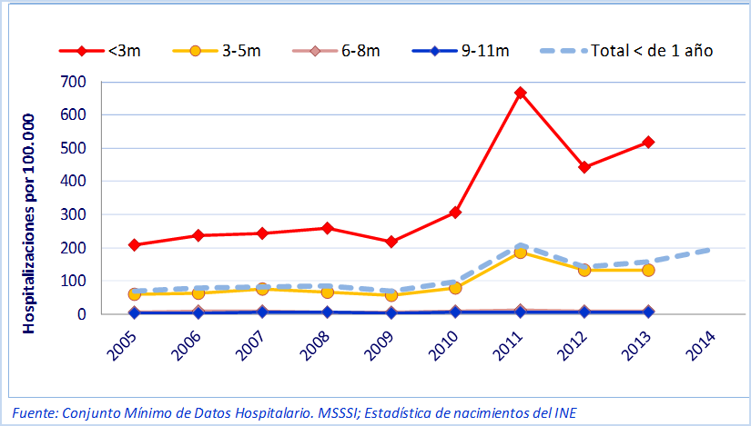
Pertussis among infants by age-subgroup Spain, 2005–2015
Incidence
Hospitalization
vaccines scheduled
<3 months = 0 - 1 dose DTPa
3-5 months = 1 -2 doses DTPa
> 6 months = 3 doses DTPa
Vaccination reduces disease severity
Inmunization “on time”
immunization the same day in which the infant turns 2, 4 and 6 months of age.

Slide 16
Deaths caused by pertussis, Spain 1965–2016
Maternal
Pertussis
Vaccination
Since 1980 to 2006, yearly an average of one death by pertussis was recorded.
Death raises from 2007 and peaked in 2011-2015, all of them younger than 3 months
Notes:
Muertes por tos ferina
1982 to 1987: 1-4 muertes al año
1988 to 1996: no muertes por tos ferina
1997- 2006: 1–2 deaths a year
2007 and 2010 reappeared and increased to 3–5 deaths a year
2011-2015: 5-10 deaths a year, all in younger than 3 months

Slide 17
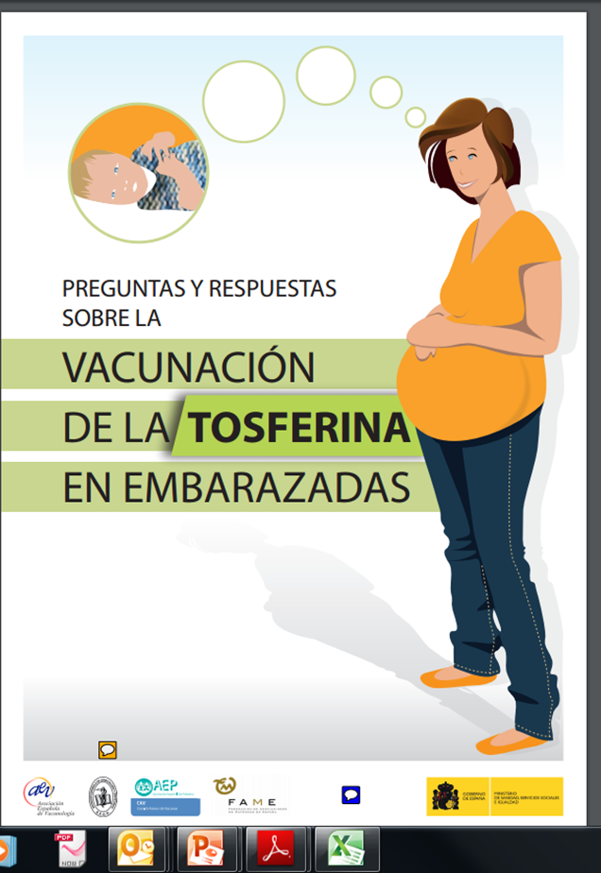
Maternal Pertussis Immunization Strategy
Response to the epidemic situation across the country
Experiences from other countries
High-moderate impact on reducing infant disease related to the coverage achieved
Protection of infants by passive antibody + reducing maternal exposure
Preliminary data suggest no blunting effect after routine primary series in infants born to mothers vaccinated during pregnancy.
No safety problems during pregnancy
Purpose: reducing Pertussis in infants younger than 3 months
(too young to be vaccinated)
Maternal Pertussis Immunization Program

Slide 18

Maternal Pertussis Immunization Program
National | Recommendation by Advisory Committee on Immunization of NHS and approved by the Public Health Commission of the Interterritorial Council of the NHS. June 2015
Autonomous Community | Decisions & Planning & Funding & Evaluation Communication strategy, Training, Guidelines Advisory Committee on Immunization of Autonomous Community Primary Care Centers & Vaccination Centers General practitioners, midwives and obstetricians
Strategy
Immunizing with dTpa vaccine between pregnancy weeks 27-28 and 36 week,
ideally between weeks 28 and 32 weeks
Immunization should be conducted in each pregnancy regardless of the previous immunization status of the pregnant woman

Slide 19
Maternal Pertussis Immunization Program
The implementation of Strategy by Autonomous Community

Slide 20
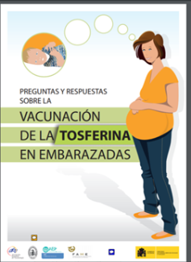
Maternal Pertussis Vaccination Strategy
The implementation of this strategy must be accompanied by the assessment of the effect in preventing pertussis in infants, both at sub-national and at national level
  Vaccination coverage & Vaccination side effects
Monitoring the effect on epidemiology of the disease in infants younger than 3 months
    .surveillance of confirmed cases
    .surveillance of hospitalizations
    .deaths
At national level a preliminary evaluation of the program will be available in 2017

Slide 21
Conclusions
Despite high vaccination coverage with 5 doses, the burden and severity of pertussis experienced high increased in the recent years in Spain. The most affected are infants younger than 3 months
Vaccination is the best way to prevent the disease, so
  Maintain high vaccination coverage and give Immunization «on time» in the first year of life
  Achieve and maintain high pertussis vaccine coverage in pregnancy
Assess the utility of the program by monitoring the impact on reducing pertussis, both at sub-national and at national level

Slide 22

Contributors:
Red Nacional de Vigilancia Epidemiológica RENAVE
Vigilancia de Enfermedades Prevenibles por Vacunación. Centro Nacional de Epidemiología, ISCIII
J Masa Calles, MV Torres de Mier y N López Perea
Gracias!!

